Slide 1
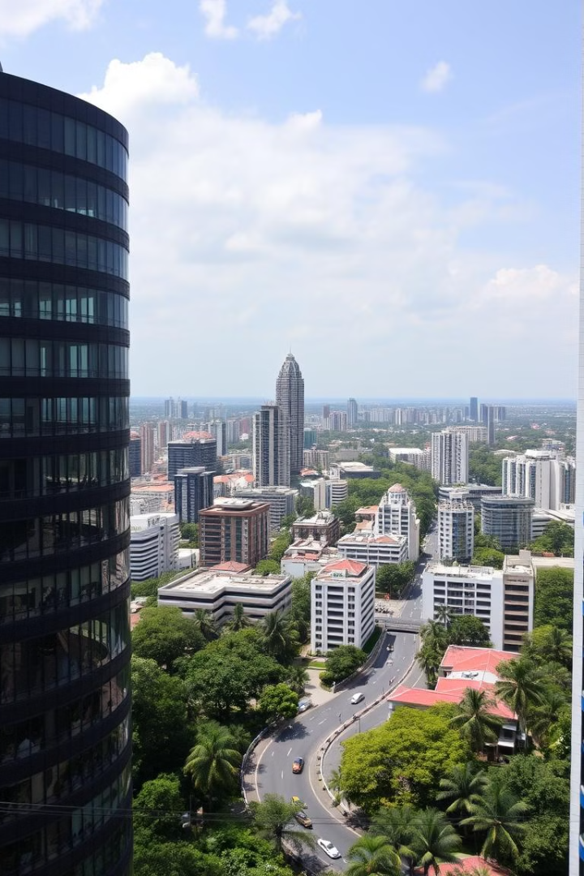
Predicting Bangalore House Rates
This project aims to help people interested in buying a home in Bangalore, India by developing a model to accurately predict house rates across the city. Using data collected from Kaggle, we'll explore the factors that influence Bangalore's dynamic real estate market.

Slide 2
Introduction to the Project
Objectives
Significance
Approach
The primary goal is to create a predictive model that can estimate the price of a house in Bangalore based on various features.
This will empower prospective home buyers with valuable insights, allowing them to make informed decisions and negotiate effectively.
The project will involve data collection, preprocessing, exploratory analysis, feature engineering, model selection, and deployment using Flask.

Slide 3




Data Collection and Preprocessing
Data Source
The dataset was obtained from Kaggle, containing 13,320 rows and 9 columns of information on Bangalore houses.
Preprocessing
The 'total_sqft' column, which provided the area in a range format, was converted to a float by taking the average.
Cleaning
The data was checked for missing values, outliers, and inconsistencies, which were then addressed to ensure data integrity.

Slide 4
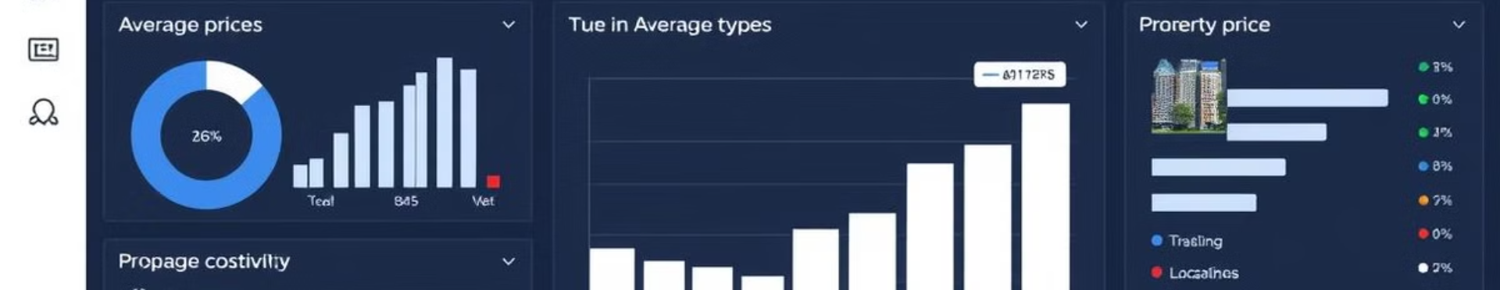
Exploratory Data Analysis (EDA)
1
Price Distribution
2
Influential Factors
3
Market Insights
The distribution of house prices in Bangalore was examined, revealing a wide range from affordable to high-end properties.
The relationship between features like location, area, and number of bedrooms with house prices was explored.
The EDA provided valuable insights into the trends and patterns in Bangalore's dynamic real estate market.

Slide 5

Feature Engineering and Selection
Feature Engineering
Feature Selection
New features were created by combining and transforming existing variables to improve the model's predictive power.
Techniques like correlation analysis and recursive feature elimination were used to identify the most important predictors.
Dimensionality Reduction
Handling Multicollinearity
Principal Component Analysis (PCA) was applied to reduce the number of features while preserving the maximum variance.
Multicollinear features were identified and addressed to ensure the model's stability and reliability.

Slide 6
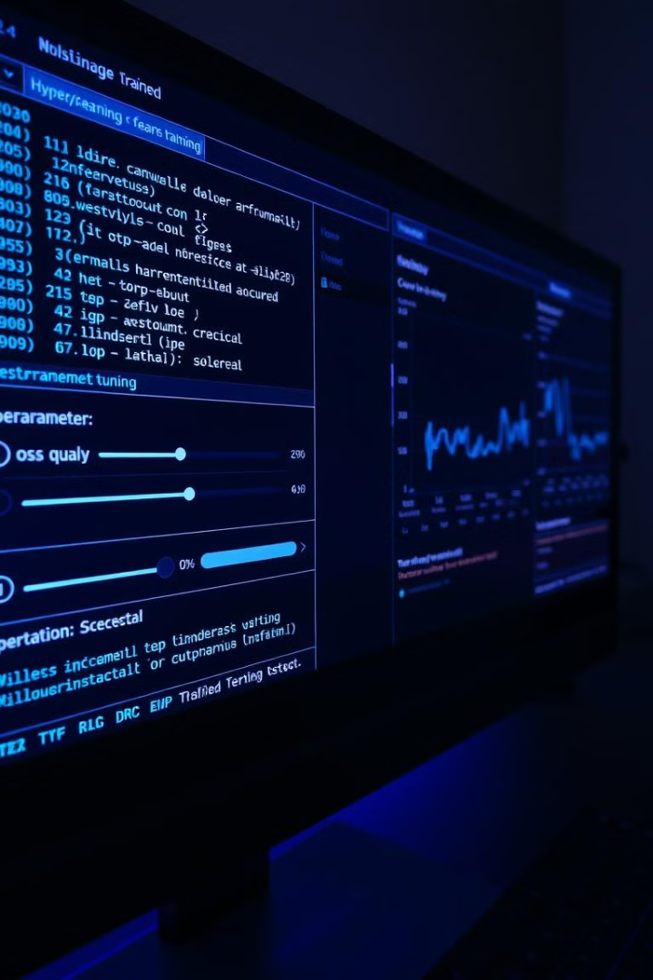




Model Selection and Training
Regression Models
Hyperparameter Tuning
Multiple regression algorithms, such as Linear Regression, Random Forest, and XGBoost, were evaluated.
The models' hyperparameters were optimized using techniques like grid search and cross-validation.
Model Evaluation
Final Model Selection
The models were assessed using various metrics, including R-squared, Mean Squared Error, and RMSE.
The best-performing model was chosen as the final solution for predicting Bangalore house rates.

Slide 7
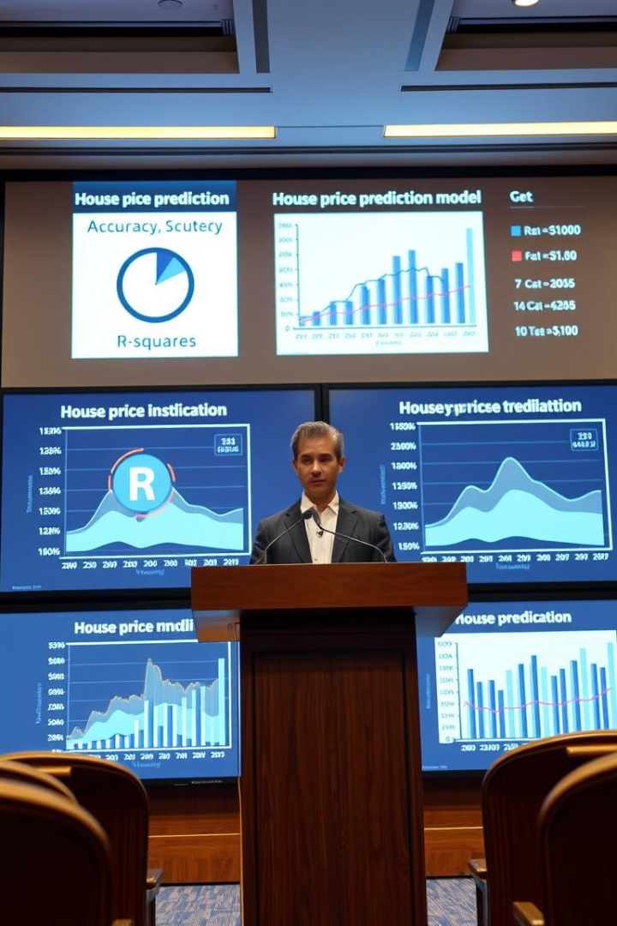
Model Evaluation and Validation
1
Train-Test Split
The dataset was divided into training and testing sets to evaluate the model's generalization performance.
2
Cross-Validation
Multiple rounds of cross-validation were performed to ensure the model's robustness and stability.
3
Performance Metrics
The model's predictive accuracy was assessed using metrics like R-squared, RMSE, and Mean Absolute Error.

Slide 8

Deployment using Flask
Requirement
Description
User Interface
A web-based interface built using Flask, allowing users to input property details and view the predicted price.
Model Integration
The trained predictive model was integrated into the Flask application to provide real-time house price estimates.
Scalability
The deployment setup ensures the solution can handle increasing user traffic and data volume.

Slide 9

Conclusion and Key Takeaways
1
Accurate Predictions
2
Empowering Home Buyers
The predictive model developed in this project can reliably estimate Bangalore house prices based on various factors.
The web-based application provides home buyers with valuable insights, enabling them to make informed decisions.
3
Future Enhancements
Ongoing data collection and model refinement can further improve the accuracy and usability of the solution.

